Slide 1
Data Analytics (CMP330)
Dr. David Glass
School of Computing
dh.glass@ulster.ac.uk
Week 6 – Data Governance, Linear and Logistic Regression
ulster.ac.uk

Slide 2
Week 6
Content
Data Governance
Types of Machine Learning
Linear regression
Model fitness and significance
Using regression as a predictive model
Evaluating a linear regression model
Logistic regression for Classification
Application of logistic regression
Odds ratios
Binary classification/prediction

Slide 3
Data Governance
“a data management function to ensure the quality, integrity, security, and usability of the data collected by an organization.”
E. Eryurek et al (2021) Data Governance: The Definitive Guide, O’Reilly
Big Data
IoT
AI
Business intelligence
Data Governance frameworks, policies, processes, etc.
Enhance Trust
Privacy, security, compliance
More accurate data analytics

Slide 4
Data Governance
Data Quality
Completeness
Uniqueness
Validity
Timeliness
Accuracy
Consistency
Fitness for purpose
https://www.ibm.com/think/topics/data-quality

Slide 5
Data Governance
Compliance with Regulations
General Data Protection Regulation (GDPR)
EU law 2018 (UK GDPR applies in UK)
Seven principles
Lawfulness, fairness and transparency
Purpose limitation
Data minimisation
Accuracy
Storage limitation
Integrity and confidentiality (security)
Accountability
https://gdpr-info.eu/art-5-gdpr/

Slide 6
Data Governance
Directed Reading
‘What is data governance?’
https://www.ibm.com/think/topics/data-governance
‘What is data quality?’
https://www.ibm.com/think/topics/data-quality

Slide 7
Types of Machine Learning
Supervised Learning
Supervised learning makes use of labelled data – for each example used in learning, the value of the desired output is available. For example, if we want to use machine learning for medical diagnosis, examples are used where the actual diagnosis is known in order to train the model.
Regression
the goal is to predict a real value
e.g. predict a company’s profit in £ based on various pieces of information about the company, an example will be considered later
Classification
the goal is to predict a categorical value (binary or a number of classes)
e.g. in medical diagnosis, predict whether a person has a particular disease based on symptoms presented

Slide 8
Types of Machine Learning
Unsupervised Learning
Unsupervised learning only involves unlabelled data. Unlike supervised learning, the goal is not to predict the value of a target variable, but to learn patterns in the data.
Clustering
the goal is to identify groups within the data
e.g. find groups of customers who have purchased similar items
Association
the goal is to find association rules within the data
e.g. customers who bought items A, B and C, also tended to buy item D.

Slide 9
Types of Machine Learning
Reinforcement Learning
Reinforcement learning involves an agent learning interactively in a complex environment rather than being programmed to act in a particular way. The agent employs trial and error along with rewards and punishments associated with the actions taken to learn how to achieve a specified goal. In effect, the agent acquires data for learning by acting in the environment and monitoring what happens.
Involves sequential decision making because it is an interactive process where each action affects the environment
Often used in conjunction with deep learning
Many applications including robotics and games, for example, Atari games and Go by DeepMind (AlphaGo Zero)

Slide 10
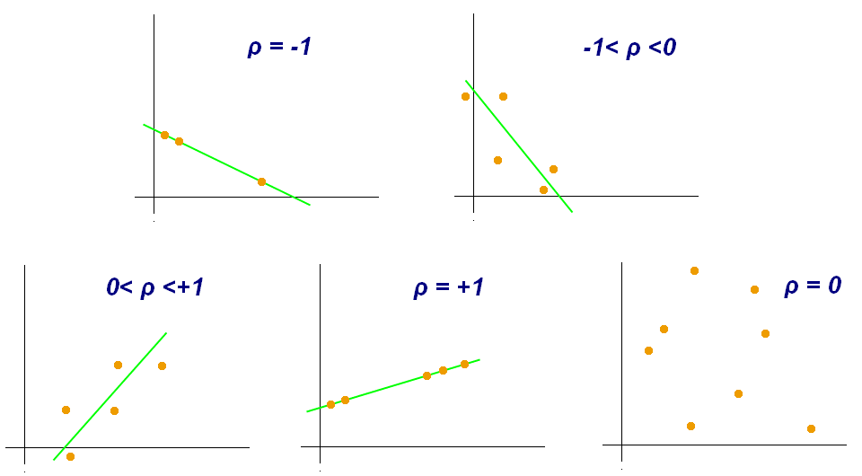
Correlation / association
Correlation
Strength of association between variables
https://en.wikipedia.org/wiki/Pearson_correlation_coefficient

Slide 11
Regression
Definition
Regression models the relationship between one or many independent variables (features) with one dependent/target variable.
Typically used to model continuous variables
Multiple regression vs. simple linear regression
https://en.wikipedia.org/wiki/Linear_regression

Slide 12
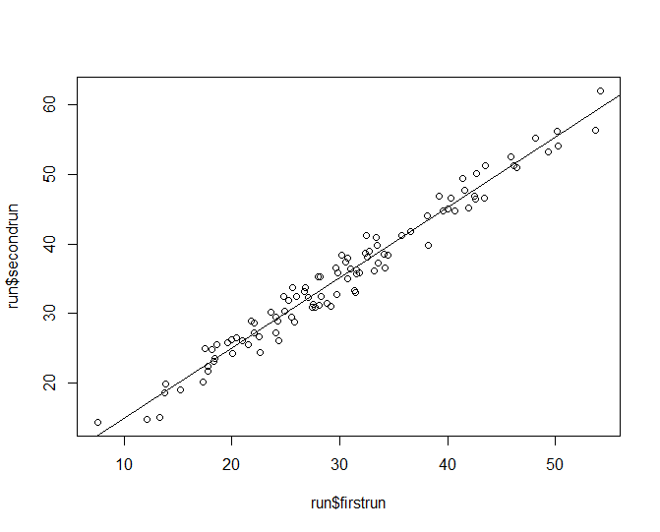
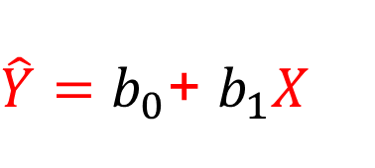
Regression
Simple Linear Regression
$\hat{Y}=b_{0}$+ $b_{1}X$

Slide 13
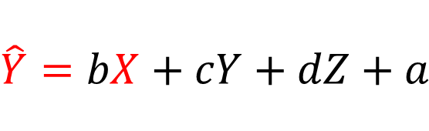
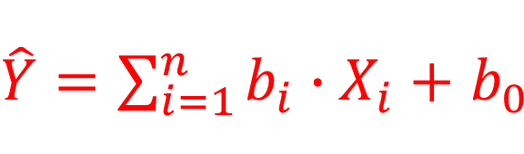
Regression
Multiple Linear Regression
$$\hat{Y}=bX+cY+dZ+a$$
$\hat{Y}=\sum_{i=1}^{n}{b_{i}∙X_{i}+}$ $b_{0}$

Slide 14
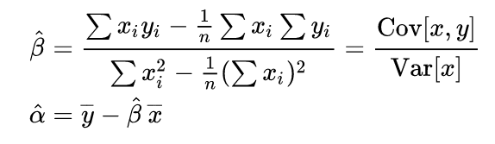
Regression
Ordinary Least Squares Regression
Finds the regression line that has the least squared error between what is predicted and the actual values.
OLS minimizes the sum of the squared residuals.
It finds b0 and b1.

Slide 15
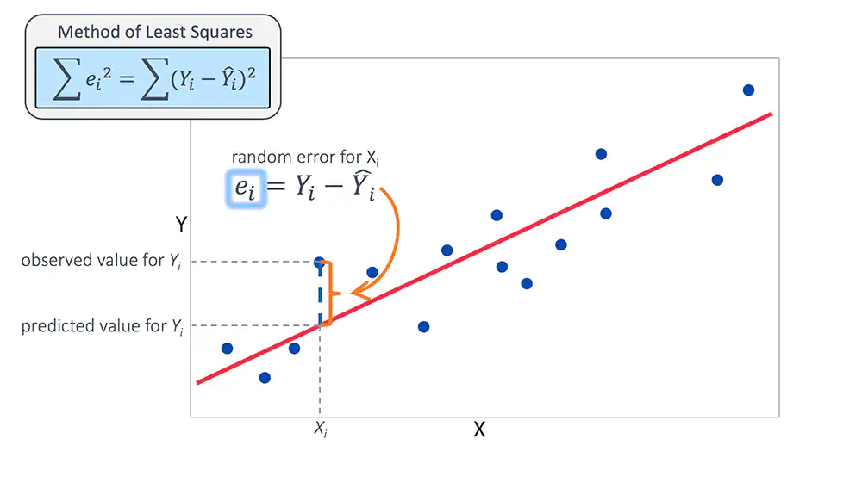
Regression
Goodness of Fit - Residuals absolute error
https://www.jmp.com/en_nl/statistics-knowledge-portal/what-is-multiple-regression/fitting-multiple-regression-model.html

Slide 16
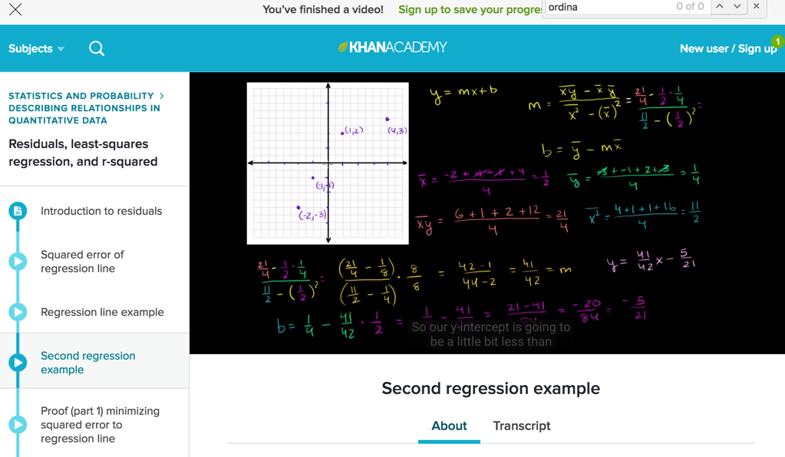
Regression
Exercise – watch online video
https://www.khanacademy.org/math/statistics-probability/describing-relationships-quantitative-data/residuals-least-squares-rsquared/v/second-regression-example

Slide 17
Regression
Goodness of Fit
How well does the regression line fit the observed data?
R Squared (R², Coefficient of determination)
R-squared is the % of the total variation which the model explains
R-squared is always between 0 and 1
R-squared is a statistical measure of how close the data are to the fitted regression line.

Slide 18
Regression
Statistical Significance in Regression - F Test
Compares a model with no predictors (intercept-only model) to your model.
“Null hypothesis: The fit of the intercept-only model and your model are equal.
Alternative hypothesis: The fit of the intercept-only model is significantly reduced compared to your model.”
http://blog.minitab.com/blog/adventures-in-statistics/what-is-the-f-test-of-overall-significance-in-regression-analysis

Slide 19
Regression
Multicollinearity
This is when multiple predictors are highly correlated meaning that coefficients maybe less interpretable

Slide 20

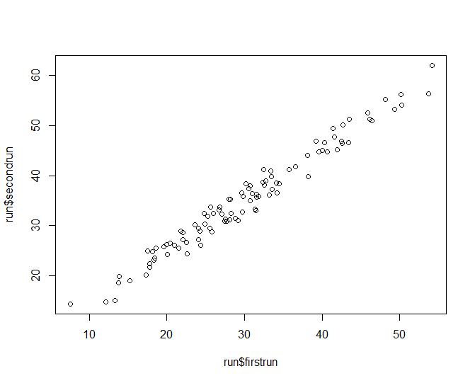
Regression
Regression Tutorial
Using run.csv

Slide 21

Regression
Regression Tutorial

Slide 22
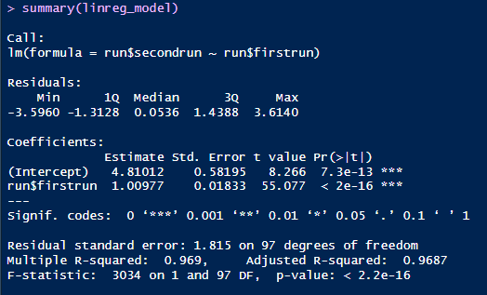

Regression
Regression Tutorial
Output using summary function.
Linear regression line: $\hat{Y}=4.81$+ $1.01X$
where $X$ is run$firstrun and $\hat{Y}$ is the predicted value of run$secondrun. $R^{2}$ value is 0.969.

Slide 23
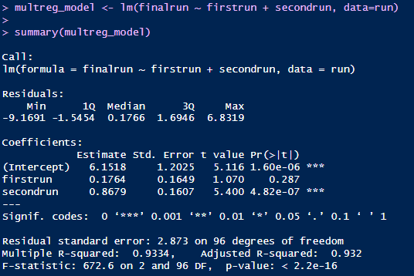
Regression
Regression Tutorial
Multiple Regression
help("~") - tilde is used to separate the left- and right-hand sides in a model formula.

Slide 24

Regression
Regression Tutorial
Create a model and predict a value

Slide 25

Regression
Regression Tutorial
Build model using 80% of the rows
Test on 20% of the rows

Slide 26
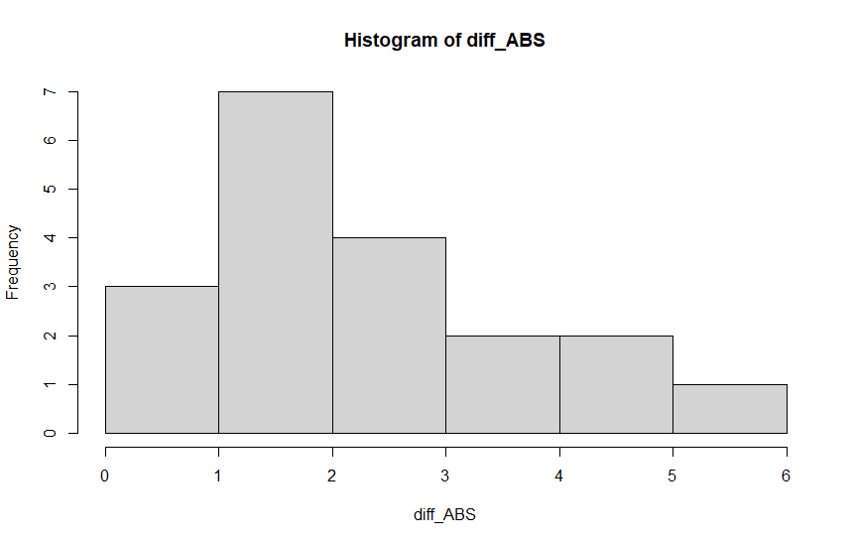
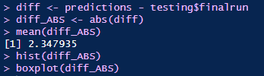
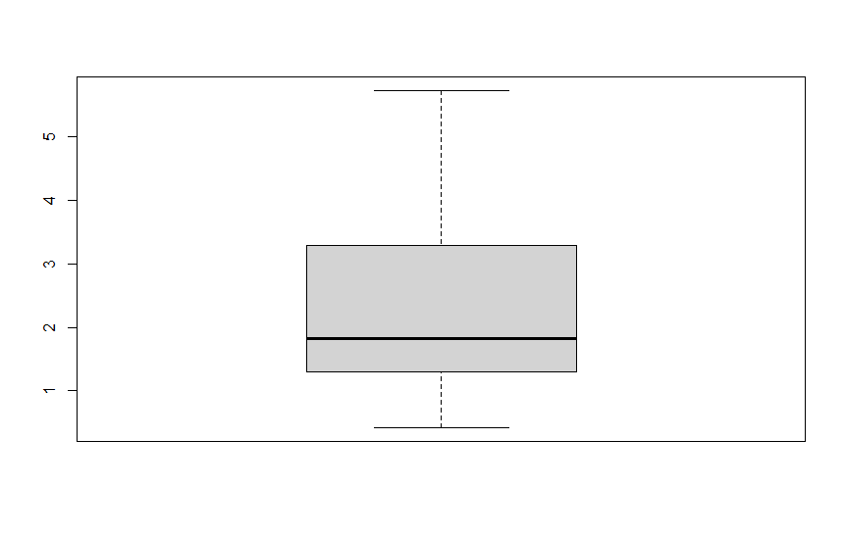
Regression
Regression Tutorial

Slide 27
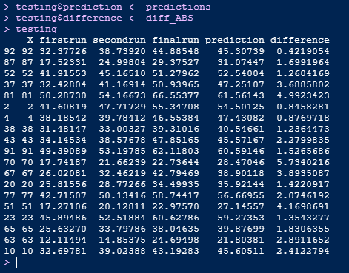
Regression
Regression Tutorial
Two new columns added

Slide 28
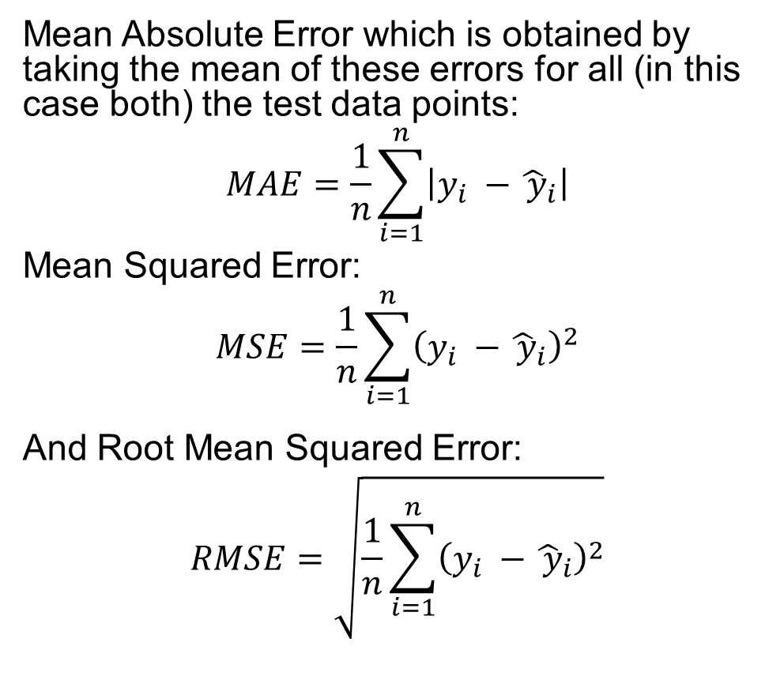
Regression
Evaluation Metrics
Mean Absolute Error which is obtained by taking the mean of these errors for all (in this case both) the test data points:
$$MAE=\frac{1}{n}\sum_{i=1}^{n}{\left|y_{i} −{\hat{ y}}_{i}\right|}$$
Mean Squared Error:
$$MSE=\frac{1}{n}\sum_{i=1}^{n}{{\left(y_{i} −{\hat{ y}}_{i}\right)}^{2}}$$
And Root Mean Squared Error:
$$RMSE=\sqrt{\frac{1}{n}\sum_{i=1}^{n}{{\left(y_{i} −{\hat{ y}}_{i}\right)}^{2}}}$$

Slide 29


Regression
Evaluation Metrics
install.packages("Metrics")
library(Metrics)
Suppose we had just used the mean value of finalrun from the training data:

Slide 30
Logistic Regression for Classification
A regression model where the dependent variable is nominal/categorical
Useful for feature engineering
Useful for binary classification
Technology adoption
Success/Unsuccess
Pass/Fail
Admitted or not admitted
Useful for calculating the Odds Ratios for each independent variable, hence good for feature selection

Slide 31
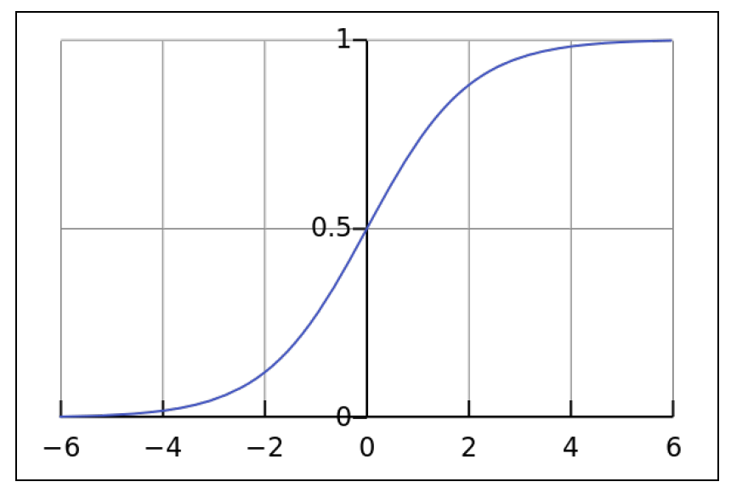

Logistic Regression for Classification
Input: can take any value from a negative infinity to a positive infinity
Output: values from 0 to 1 (a probability)

Slide 32
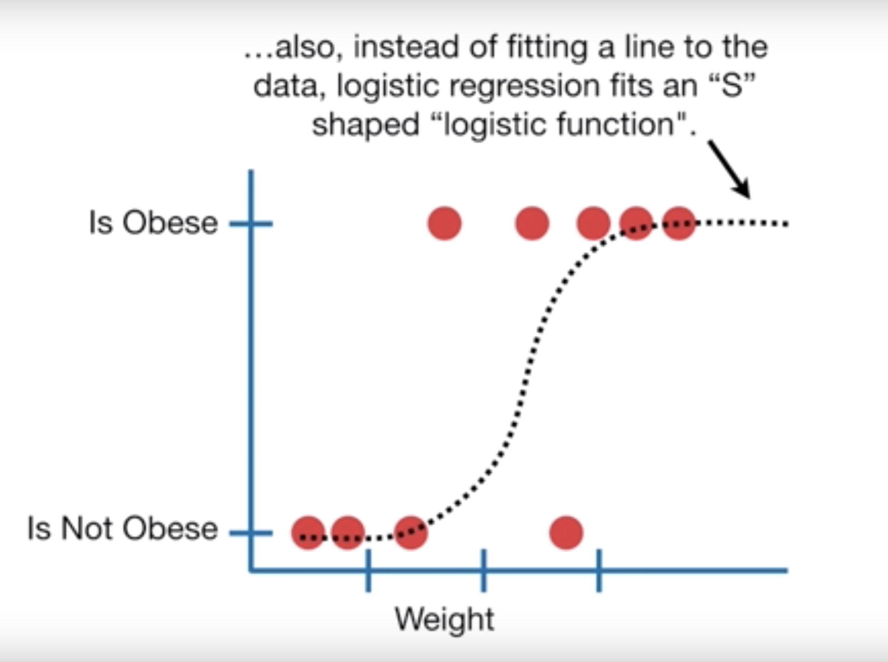
Logistic Regression for Classification
Online Exercise
StatQuest: Logistic Regression.
https://www.youtube.com/watch?v=yIYKR4sgzI8

Slide 33
Classification
Model evaluation - Confusion matrix
Suppose we are using various classifiers to diagnose diabetes based on various medical features. There are four possibilities:
True Positive (TP) – classifier predicts positive (diabetes) and actual result is positive
False Positive (FP) – classifier predicts positive and actual result is negative (Type I error)
True Negatives (TN) – classifier predicts negative (no diabetes) and actual result is negative
False Negative (FN) – classifier predicts negative and actual result is positive (Type II error)
Actual Result
 | Positive | Negative
Positive | TP | FP
Negative | FN | TN
Predicted Result

Slide 34

Classification
Model evaluation – Evaluation Metrics
Suppose there are 100 test cases and the results are as follows:
70 TNs, 15 TPs, 10 FPs, 5 FNs.
$$Accuracy= \frac{TP+TN}{TP+TN+FP+FN}=85\%$$
$$Sensitivity (or Recall)= \frac{TP}{TP+FN}=75\%$$
$$Specificity= \frac{TN}{TN+FP}=87.5\%$$
$$Precision= \frac{TP}{TP+FP}=60\%$$
$$F1 Score= \frac{2TP}{2TP+FP+FN}=66.7\%$$
Actual Result
 | Positive | Negative
Positive | 15 | 10
Negative | 5 | 70
Predicted Result

Slide 35
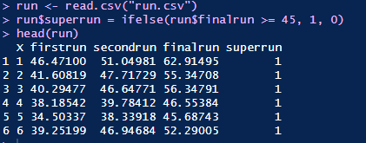
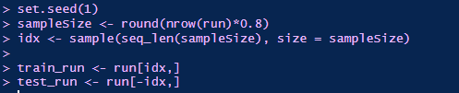
Logistic Regression
Exercise
Suppose that instead of the finalrun variable being real-valued it was binary. (Here we set values below 45 to 0 and otherwise to 1.
Then split training and test data

Slide 36
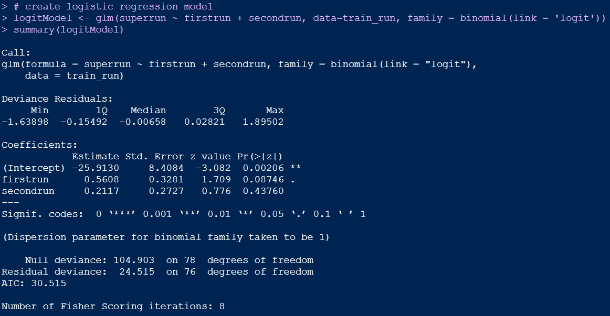
Logistic Regression
Exercise
Create logistic regression model

Slide 37
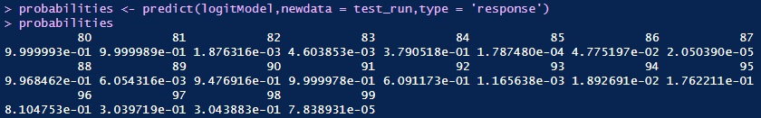

Logistic Regression
Exercise

Slide 38
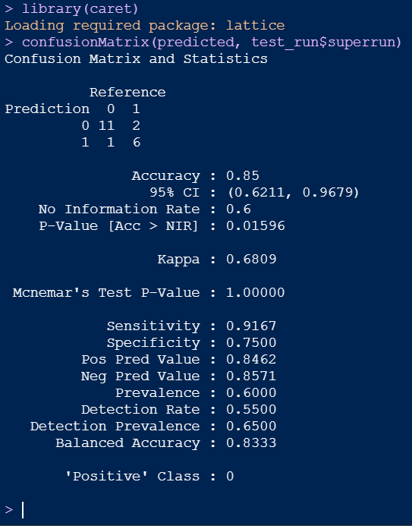
Logistic Regression
Exercise
Model evaluation using confusion matrix

Slide 39
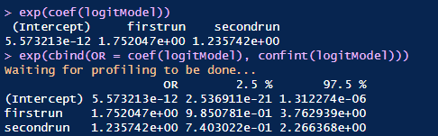
Logistic Regression
Exercise
exp(coef(logitModel)) # odds ratios only
exp(cbind(OR = coef(logitModel), confint(logitModel)
# odds ratios and 95% CI

Slide 40
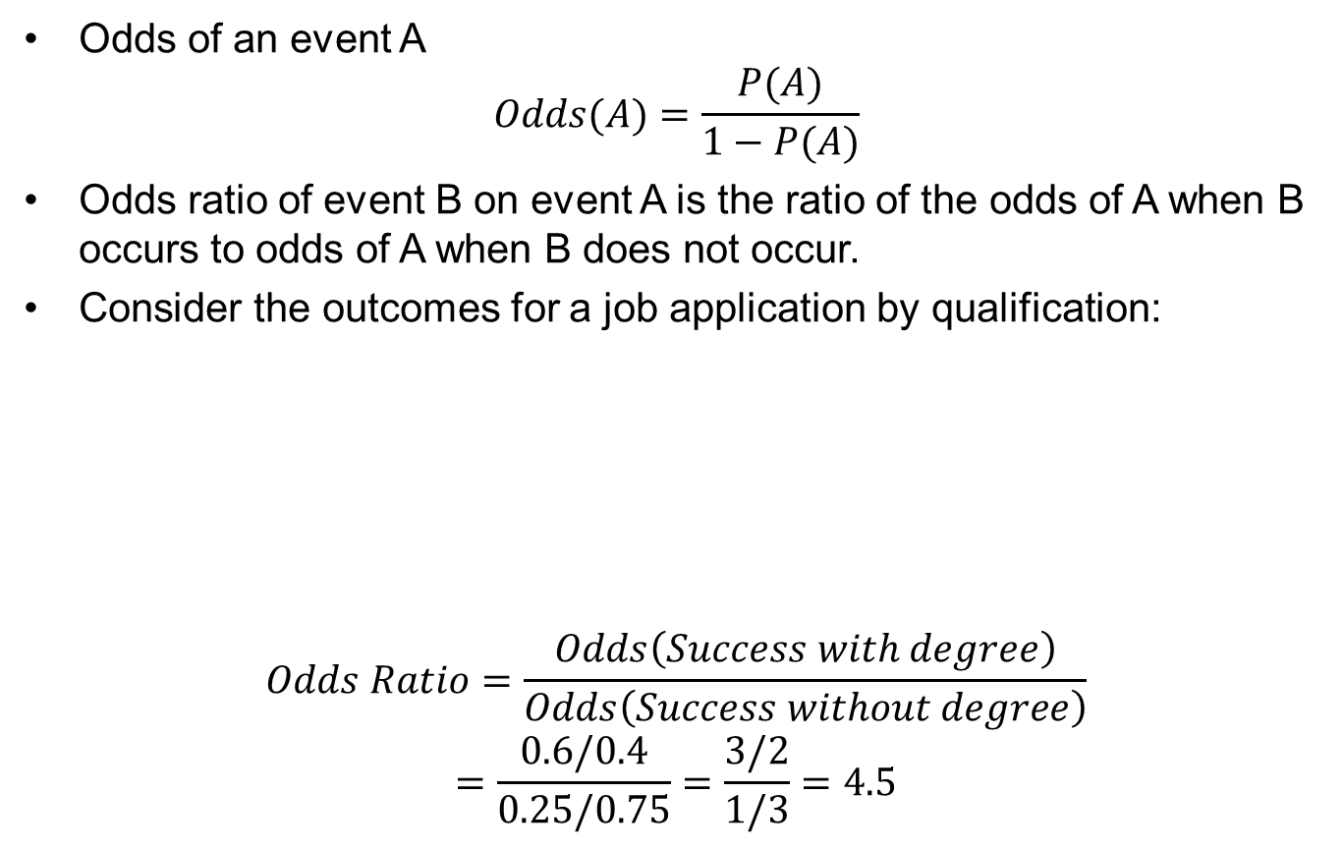
Odds and Odds Ratio
Odds of an event A
$$Odds(A)=\frac{P(A)}{1−P(A)}$$
Odds ratio of event B on event A is the ratio of the odds of A when B occurs to odds of A when B does not occur.
Consider the outcomes for a job application by qualification:
$$Odds Ratio=\frac{Odds\left(Success with degree\right)}{Odds\left(Success without degree\right)}$$
$$=\frac{0.6/0.4}{0.25/0.75}=\frac{3/2}{1/3}=4.5$$
 | Successful | Unsuccessful
Degree | 60 | 40
No degree | 25 | 75

Slide 41
Logistic Regression
Odds ratios
How do I interpret odds ratios in logistic regression?
https://stats.oarc.ucla.edu/stata/faq/how-do-i-interpret-odds-ratios-in-logistic-regression/

Slide 42
Logistic Regression
To learn more - watch
Stats quest:
Logistic regression overview
https://www.youtube.com/watch?v=yIYKR4sgzI8
Logistic regression coefficients
https://www.youtube.com/watch?v=vN5cNN2-HWE
Maximum likelihood
https://www.youtube.com/watch?v=BfKanl1aSG0
R squared and p values for logistic regression
https://www.youtube.com/watch?v=xxFYro8QuXA
Odds ratios from logit
https://www.youtube.com/watch?v=8nm0G-1uJzA

Slide 43
Statistical Model vs. ML algorithm
What is the difference?
Read:
https://www.analyticsvidhya.com/blog/2015/07/difference-machine-learning-statistical-modeling/

Slide 44
Further Reading
Gareth, J., Daniela, W., Trevor, H. and Robert, T., 2013. An introduction to statistical learning: with applications in R. Springer. (Chapter 3)
Lantz, Brett. Machine learning with R. Packt Publishing Ltd, 2013 (Chapter 6)
https://stats.idre.ucla.edu/r/dae/logit-regression/
https://www.scribbr.com/statistics/linear-regression-in-r/
https://www.machinelearningplus.com/machine-learning/complete-introduction-linear-regression-r/

